Slide 1
\LaTeX
For Scientific Documentation
By Ammar Taha Mohamedy
LaTeX as a Calculator

Slide 2
The calculator Package
1
Basic Arithmetic: add, subtract, multiply and divide.
2
Compute powers, square roots, exponentials.
3
Work with Logarithms, trigonometric and hyperbolic functions.
4
Work with Vectors in two and three dimensions, and Square Matrices.
Working Methodology
The Package performs simultaneous calculation & storing of the result in a new variable.
\ADD{8}{7}{\Result}
Calling \Result gives 15

Slide 3
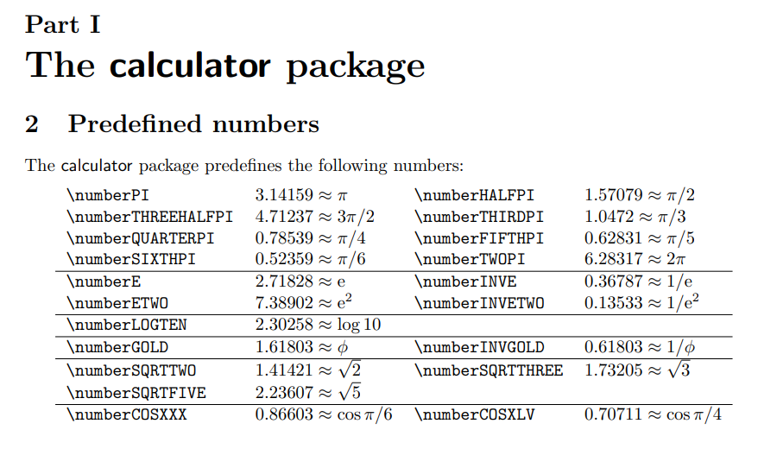
Predefined Numbers

Slide 4

Other Operations on Integers & Real Numbers
Square of a Number
\SQUARE{2.2}{\sq}
\sq gives (4.83998)
Cube of a Number
\CUBE{3.2}{\qb}
\qb gives (32.76788)
Exponent Power of a Number
$$3^{5}$$
\POWER{3}{5}{\threexp}
\threexp gives (243)
Absolute Value of a Number
\ABSVALUE{-2.35}{\absval}
\absval gives (2.35)
Floor of a Number
\FLOOR{2.23}{\floorval}
\floorval gives (2)

Slide 5
Other Operations on Integers & Real Numbers
\sq is 4.83998
Truncate a Number
\TRUNCATE[3]{\sq}{\smallsq}
\smallsq gives (4.839)
Round a Number
\ROUND[1]{2.3564}{\rndval}
\rndval gives (2.4)
Modulus
\MODULO{5}{3}{\modulus}
\modulus gives (2)
Greatest Common Divisor
\GCD{520}{350}{\greatdiv}
\greatdiv gives (10)
Least Common Multiple
\LCM{25}{79}{\leastcom}
\leastcom gives (1975)

Slide 6
Operations on Vectors and Matrices
The Package only works with two or three dimensional vectors.
Meaning column vectors that has two or three elements.
Assigning Vectors
Two-Dim → \VECTORCOPY (a, b)(\cmda, \cmdb)
Three-Dim → \VECTORCOPY (a, b, c)(\cmda, \cmdb, \cmdc)
The package can only handle operations of square matrices of size 2x2 and 3x3.
Assigning Matrices
2x2 → \MATRIXCOPY (a, b ; c, d)(\cmda, \cmdb ; cmdc, \cmdd )
3x3 → \MATRIXCOPY (a11, a12, a13 ; …)(Assigning Commands)

Slide 7
The calculus Package
Input Number
Solution of the Function
\SQUAREfunction{num}{\sol}{\Dsol}
Derivative of Func Evaluated at Input Number
If we have an input t = 3, and the square function is f(t)=t^2, and this has a derivative of f’(t)=2t
\SQUAREfunction{3}{\threesol}{\Dthreesol}
\threesol is f(3)=3^2 → 9
\Dthreesol is f’(3)=2*3 → 6

Slide 8
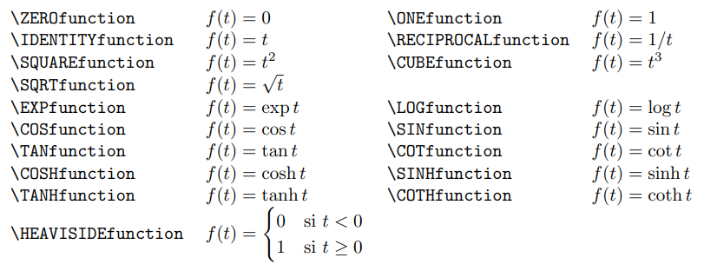
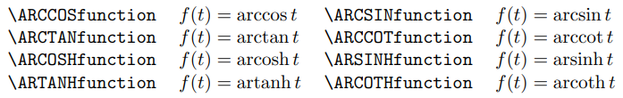
Predefined Elementary Functions

Slide 9
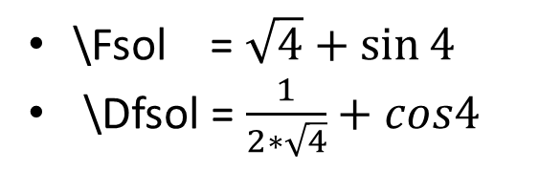
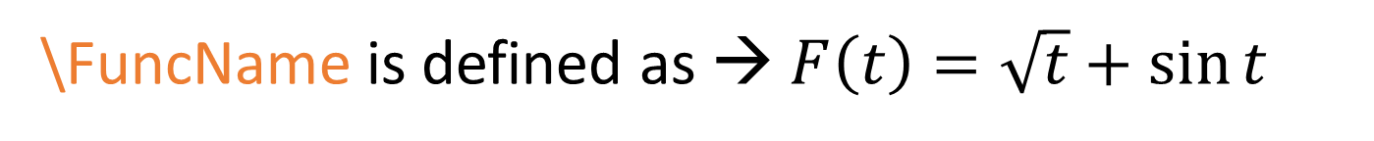
Operations on Functions
We apply some basic operations on built-in functions.
We store the result in a new function <\FuncName>
\SUMfunction{\function1}{\function2}{\FuncName}
\SUMfunction{\SQRTfunction}{\SINfunction}{\FuncName}
\FuncName is defined as → $F\left(t\right)=\sqrt{t}+\sin{t}$
\Fsol = $\sqrt{4}+\sin{4}$
\Dfsol = $\frac{1}{2∗\sqrt{4}}+cos4$
\FuncName{4}{\Fsol}{\DFsol}

Slide 10
Thanks for Watching !!

